Slide 1
string
MAN
http://teacher.buet.ac.bd/ali_nayeem/CSE109_Feb2015/

Slide 2
CT3 on Array, String
Next Next Sunday 17/5/15
Materials:
  2 slides
  Only relevant sections from
    TUC: Ch 5
    LUC: Ch 8,9

Slide 3
Recap: Character in c

Slide 4
Character Constants
Size 8 bits
Like small integer (0-255)
Rules for constructing character constant
  a single alphabet, a single digit or a single special symbol enclosed within single inverted commas.
  The maximum length of a character constant can be 1 character.
Example
  'A'
  'I'
  '5'
  '='

Slide 5
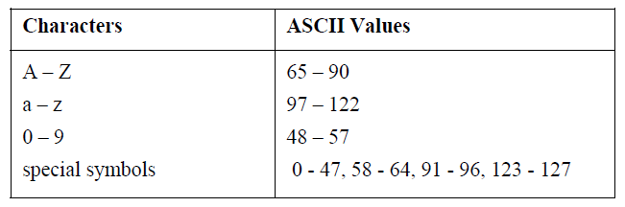
How character is stored in memory
Needs represent character by integer
Needs a standard
  American Standard Code for Information Interchange (ASCII)

Slide 6
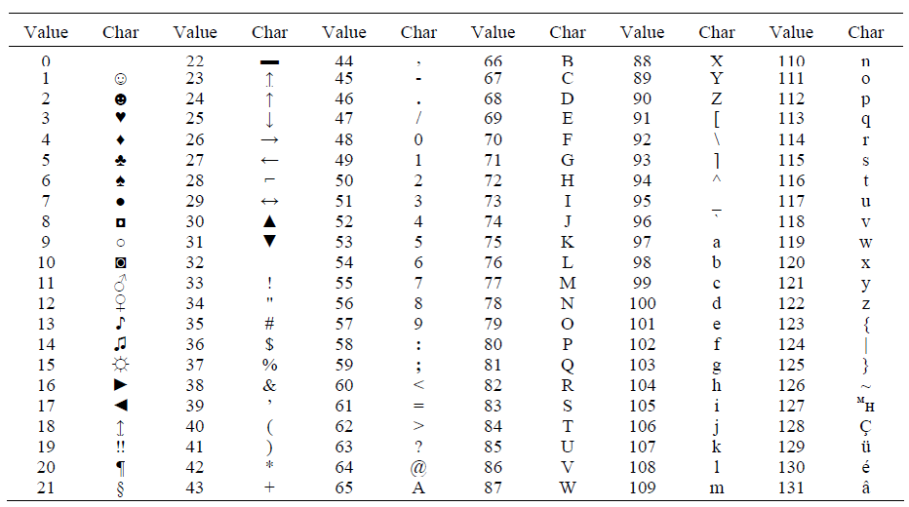
ASCII

Slide 7
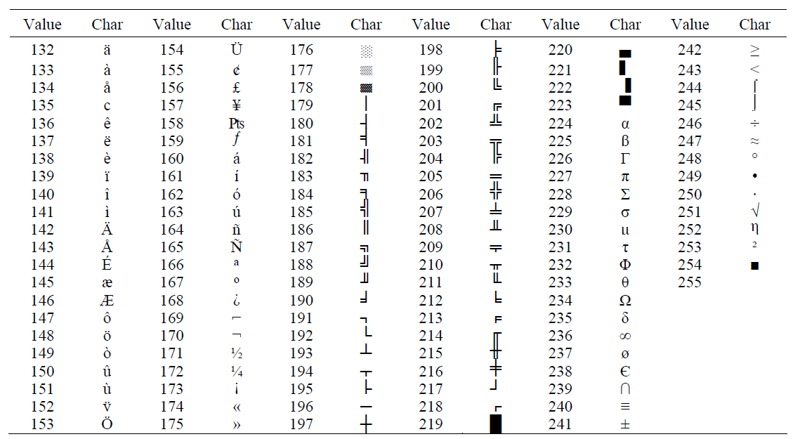
ASCII

Slide 8
Character Variable
Type char
Format specifier %c for printf and scanf
ASCII values of the characters are stored in the variables.
char a, b, d ;
a = 'F' ;
b = 'G' ;
d = '+' ;

Slide 9
Arithmetic Operators
  +
  -
  *
  /
  %

Slide 10
Input characters
getche()/getch()/getchar/scanf() can be used
getchar()
  Compiler dependent behaviour
  Waits until carriage return
  Read only one char
  Other input and carriage return will be in buffer
  Subsequent input (e.g, scanf) will consume them
  Can cause trouble
  Defined in stdio.h
getche()/getch()
  Return immediately after a key is pressed
  Defined in conio.h

Slide 11
String
Most common use of one dimensional array is string
One dimensional character array terminated by a null (‘\0’)
‘\0’ & ‘0’ are not same
ASCII Value of ‘\0’ is 0
ASCII Value of ‘0’ is 48
Array size must be at least one byte larger than the string size to make room for the null
Terminating null is important
  Indicates where string ends
A string constant is automatically null-terminated by the compiler

Slide 12
String
char dept[]={‘E’, ‘E’, ‘E’, ‘\0’};
char dept[]=“EEE”; /*string constant*/
  Shortcut for initializing string
  ‘\0’ is not necessary in this declaration
 | dept[0] | dept[1] | dept[2] | dept[3]
dept | E | E | E | \0
 | 4001 | 4002 | 4003 | 4004

Slide 13
String
#include<stdio.h>
int main()
{
char course[]="CSE109";
int i=0;
while(course[i])
{
printf("%c\n", course[i]);
i++;
}
return 0;
}
Output:
C
S
E
1
0
9

Slide 14
String
Null
  False
  Value 0

Slide 15
String Read
%s
  In scanf
  Reads characters untill ENTER pressed
  ENTER key is not stored, replaced with null character
  No bound checking
  Can not read multi word string separated by space
    “Department Name: EEE”
  scanf(“%s”, s);

Slide 16
String Read
gets()
  Library function
  Defined in stdio.h
  Call it using the name of the character array without using index
    gets(s)
  Reads characters untill ENTER pressed
  ENTER key is not stored, replaced with null character
  No bound checking
  Can receive multiword string

Slide 17
String Write
%s in printf
  printf(“%s”, s);
puts()
  puts(“hello”)
  puts(s)

Slide 18
Memory layout
Each character occupies one byte of memory
Number of possible values in a string of length 3 is 255³
 | dept[0] | dept[1] | dept[2] | dept[3]
dept | ‘E’ | ‘E’ | ‘E’ | ‘\0’
 | 4001 | 4002 | 4003 | 4004

Slide 19
Can you find?
The length of a string
Check whether a string is palindrome?
  abcdcba
  acca
Lowercase/uppercase
Frequency of each character in a string
  aabegggfdd
    a:2
    b:1
    d:1
    e:1
    f:1
    g:3

Slide 20
Uses of strings
Working with very large integers
  Suppose you are given a large integer. The integer may have up to 128 decimal digits. You have to detect whether the integer is divisible by 3 or not.
  Hint: A number is divisible by 3 if the sum of its digits is divisible by 3.

Slide 21
String Library Functions
Required to include string.h
Strlen() : Finds the length of the string
strcat( to, from): : Appends one string at the end of the other
strcpy( to, from): Copies one string into another
strcmp (s1, s2): Compares two strings
  Returns 0 if same
  -ve if s1 less than s2
  +ve if s1 greater than s2

Slide 22
String Library Functions
strcpy
char str1[]="CSE110";
char str2[]="CSE109";
for(int i=0; str2[i]!=‘\0’,;i++)
str1[i]=str2[i];
str1[i]=‘\0’;

Slide 23
Can you solve it?
Take as input the names of N students and find how many names contain the word “nayeem”

Slide 24
String Tables
2D array of characters
Arrays of strings
  Each element is a string
char names[10][40]
  10 names (strings) each can hold 40 characters at most including null
gets(names[2]);
printf(names[1]);

Slide 25
Initialize
char names[][10]={
“Joy”,
“Fahad”,
“Alamin”,
“Noman”,
“Tareq”
};
1001 | J | o | y | \0
1011 | F | a | h | a | d | \0
1021 | A | l | a | m | i | n | \0
1031 | N | o | m | a | n | \0
1041 | T | a | r | e | q | \0 |  |  |  |  | 1050 (last location)

Slide 26
Thanks to
Johra Muhammad Moosa
  Lecturer
  Department of Computer Science & Engineering
  Bangladesh University of Engineering & Technology

