Slide 1
Pointer

Slide 2
Pointers
What is pointer?
  A variable that can hold an Address
Why pointers?
  Sometimes the only way to express a computation
    dynamic memory allocation
  Usually lead to compact and efficient code
Related operators:
  * : can be used in two ways
    In declaration : read as pointer, e.g., int *p;
    In accessing : read as content of, e.g., x = *p;
    No relation with multiplication
  & : returns address of a variable
    Read as address of

Slide 3
Pointer Examples
int x = 70, y = 80, z[4] = {10, 20, 30, 40 };
int *ip; // int pointer ip
ip = &x; // ip is assigned to address of x
*ip = 200; // content of ip is assigned to 200
y = *ip; // y is assigned to content of ip
ip = &z[2];
*ip = *ip + 20; // same as *ip += 20;
y = *ip+1;
70
x :
4892
200
200
80
y :
4896
51
Z, Z[0] :
4900
10
Z[1] :
4904
20
50
Z[2] :
4908
30
Z[3] :
4912
40
????
4892
ip :
4916
4908

Slide 4
Pointers in Function arguments
Arguments are passed by value, thus only a copy is passed.
void swap_wrong(int x, int y)
{
int temp;
temp = x;
x = y;
y = temp;
}
in swap_wrong
in swap
x:
10
px:
4397
y:
20
py:
9643
void swap(int *px, int *py)
{
int temp;
temp = *px;
*px = *py;
*py = temp;
}
temp:
temp:
in caller:
a:4397
10
int a = 10, b = 20;
swap_wrong(a, b);
printf(“a=%d, b=%d”, a, b);
swap(&a, &b);
printf(“a=%d, b=%d”, a, b);
b:9643
20

Slide 5
Pointer Operations
The valid pointer operations are
  Adding or subtracting a pointer and an integer (p ± i)
    Meaningful in the context of array
  Assignment of pointers of the same type (p = q)
  Subtracting or comparing two pointers in same array (p - q)
    Meaningful in the context of array
  Assigning or comparing to zero or NULL. (p = 0 or p = NULL)
All other pointer arithmetic are illegal.

Slide 6
Pointer with Arrays
Output:
0. value=1, address=1638196
1. value=2, address=1638200
2. value=3, address=1638204
3. value=4, address=1638208
4. value=5, address=1638212
int main()
{
int num[]={1, 2, 3, 4, 5};
for(int i=0; i<5; i++)
{
printf("%d. value=%d, address=%d\n", i, num[i], &num[i]);
}
return 0;
}
Array elements are stored in contiguous memory location
Address output will be in hexadecimal if %p is used

Slide 7
Pointer with Arrays
Array name without index: address of the start of the array
int a[5]={1,2,3,4,5};
int *p;
p=a;
printf("%d %d %d\n",*p, *(p+1), *(p+2));
printf("%d %d %d\n",a[0], a[1],a[2]);
* has higher precedence then + so parentheses necessary

Slide 8
Addition/Subtraction of int to a pointer
Used for pointing to different elements in an array
Performed relative to the type of the pointer
Each increment will cause the pointer to point to the next item
int a[6], *pa, x, i;
pa = &a[2]; // same as pa = a + 2;
*pa ⇔ pa[0] ⇔ a[2]
*(pa-i) ⇔ pa[-i] ⇔ a[2-i]
*(pa+i) ⇔ pa[i] ⇔ a[2+i]
pa-2
pa-1
pa:
pa+1
pa+2
pa+3
a:
a[0]
a[1]
a[2]
a[3]
a[4]
a[5]
pointer ± int ⇒ pointer

Slide 9
Pointer Increment
Output:
0. value=1
1. value=2
2. value=3
3. value=4
4. value=5
int main()
{
int num[]={1, 2, 3, 4, 5};
int i, *j;
j=&num[0];
for(i=0; i<5; i++)
{
printf("%d. value=%d\n", i, *j);
j++;
}
return 0;
}

Slide 10
Pointer Increment
Output:
0. value=1
1. value=2
2. value=3
3. value=4
4. value=5
int main()
{
int num[]={1, 2, 3, 4, 5};
int i, *j;
j=num;
for(i=0; i<5; i++)
{
printf("%d. value=%d\n", i, *j);
j++;
}
return 0;
}

Slide 11
Pointer with Arrays
Array name gives the base address of the array
Array name always points to the beginning of the array
An array name is a constant pointer
Pointer is a variable but the array name is not
Can not be modified by pointer arithmetic
So the expression
  num++
  num+=3 (shortcut for num = num + 3)
are invalid

Slide 12
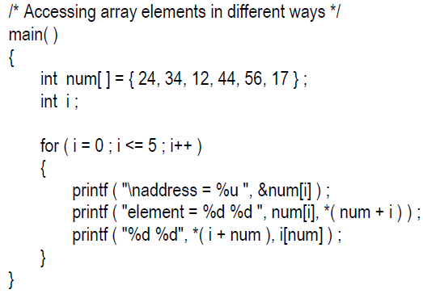
Pointer with arrays
Array name gives the base address of the array
Base address: address of the first element / element at index zero
So *num/ *(num+0) gives the value of the first element
num[i]: compiler converts it to *(num+i)
The following notations are same
  num[i]
  *(num+i)
  *(i+num)
  i[num]
Output:
address = 65512 element = 24 24 24 24 address = 65516 element = 34 34 34 34 address = 65520 element = 12 12 12 12 address = 65524 element = 44 44 44 44 address = 65528 element = 56 56 56 56 address = 65532 element = 17 17 17 17

Slide 13
Pointer Subtraction
Subtraction
One pointer can be subtracted from other
  Number of elements separating them can be found
  Meaningless unless performed on an array

Slide 14
Pointer Subtraction
int main()
{
int num[]={1, 2, 3, 4, 5, 6, 7, 8};
int *p, *q;
p=&num[2];
q=&num[5];
printf("%d\n", q-p);
return 0;
}
Returns 3, not 12

Slide 15
Pointer Subtraction
int main()
{
int num[]={1, 2, 3, 4, 5, 6, 7, 8};
int *p, *q;
p=&num[2];
q=&num[5];
printf("%d\n", p-q);
return 0;
}
Returns -3

Slide 16
Passing entire array to a function
void display ( int j[], int n )
{
  int i ;
  for ( i = 0 ; i <= n - 1 ; i++ )
  {
  printf ( "element = %d \n", j[i] ) ;
  }
}
int main( void)
{
  int num[ ] = { 24, 34, 12, 44, 56, 17 } ;
  dislpay ( num, 6 ) ;
}
void display ( int *j, int n )
{
  int i ;
  for ( i = 0 ; i <= n - 1 ; i++ )
  {
    printf ( "element = %d \n", *j ) ;
    j++ ; /* increment pointer to point to next element */
  }
}

Slide 17
Passing entire array to a function
void display ( int j[], int n )
{
  int i ;
  for ( i = 0 ; i <= n - 1 ; i++ )
  {
  printf ( "element = %d \n", j[i] ) ;
  }
}
int main( void)
{
  int num[ ] = { 24, 34, 12, 44, 56, 17 } ;
  dislpay ( num+2, 4 ) ;
}
void display ( int *j, int n )
{
  int i ;
  for ( i = 0 ; i <= n - 1 ; i++ )
  {
    printf ( "element = %d \n", *j ) ;
    j++ ; /* increment pointer to point to next element */
  }
}

Slide 18
Pointers and String
int main()
{
char str[]="CSE 109";
char *p;
int i;
p=str;
for( i=0; p[i]; i++)
{
printf("%c", p[i]);
}
while(*p)
{
printf("%c", *p);
p++;
}
return 0;
}
Output:
CSE109CSE109
If the order of while loop and the for loop is exchanged
the code will not work
Find out why?

Slide 19
Pointers and String
#include<stdio.h>
int main()
{
char *p;
p="CSE 109";
printf(p);
return 0;
}
C compiler stores "CSE 109“ in memory, then assigns it’s address to p

Slide 20
Pointer Vs Array
char amessage[] = “now is the time”; // an array
char *pmessage = “now is the time”; // a pointer
amessage:
now is the time\0
pmessage:
now is the time\0
pmessage
  A pointer which can hold one addrress
  Can refer to different storage
    Example: pmessage = amessage;
  Result is undefined if you try to modify the string contents
amessage
  An array of size 15+1
  Always refer to the same storage
  Individual character can be changed
    Example: amessage[5]= ‘z’;

Slide 21
Pointer Vs Array
char amessage[] = “now is the time”; // an array
char *pmessage = “now is the time”; // a pointer
amessage:
now is the time\0
pmessage:
now is the time\0
pmessage has address
  pmessage is pointer and requires 2/4 bytes for itself
  pmessage++ is possible
  pmessage=somepointer is legal
amessage has no address
  amessage is a name for the starting address of the array
  amessage++ is illegal
  amessage=somepointer is illegal

Slide 22
String Library Functions
Required to include string.h
Strlen(char * s) : Finds the length of the string s
strcat(char * to, char * from): Appends one string at the end of the other
strcpy(char * to, char * from): Copies one string into another
strcmp (char *s1, char *s2): Compares two strings
  Returns 0 if same
  -ve if s1 less than s2
  +ve if s1 greater than s2

Slide 23
Comparing/Subtraction to Pointer
The resulting type of subtracting two pointers is integer.
Comparison Vs. Subtraction
  a < b ⇔ a – b < 0
  a == b ⇔ a – b == 0
  a > b ⇔ a – b > 0
Compared/Subtracted pointers should point in same array.
Example:
/* strlen: return length of string s*/
int strlen(char *s) {
char *p = s;
while (*p != ‘\0’)
p++;
return p – s;
}
pointer - pointer ⇒ int

Slide 24
Comparing/Assigning to Zero
Zero is the only integer that can be assigned to a pointer
Zero is the only integer that a pointer can be compared to.
Use this to initialize a pointer and to check validity
  char *m = 0;
  ...
  if (m != 0)
  { ... safe to use the pointer ... }
NULL can be used instead of 0
  char *m = NULL;
  if (m != NULL)
  {
  }

Slide 25
strcpy example
/* strcpy: copy t to s */
void strcpy(char *s, char *t)
{
int i;
i = 0;
while ((s[i] = t[i])!=‘\0’)
i++;
}
Note: if you just write s=t then only the pointer will be copied, not the characters
/* strcpy: copy t to s */
void strcpy(char *s, char *t)
{
while ((*s = *t)!=‘\0’) {
s++;
t++;
}
}

Slide 26
Pointer Vs Array
In function argument array and pointer are same. i.e., following declaration/definition of function are equivalent
  int strlen(char *str)
  int strlen(char str[ ])
Arguments are passed by value, thus only a copy of address is passed
/* strcpy: copy t to s */
void strcpy(char *s, char *t)
{
while (*s = *t) {
s++;
t++;
}
}
………
char p[25];
char *q = “Hello world”;
strcpy(p, q);
s:
4397
t:
9643
4397
p:
q:
Hello world\0
9643
What is the effect of writing s=t?

Slide 27
strcmp example
/* strcmp: return <0 if s<t, 0 if s==t, >0 if s>t */
int strcmp(char *s, char *t)
{
int i;
for (i = 0; s[i] == t[i]; i++)
{
if (s[i] == ‘\0’)
return 0;
}
return s[i] – t[i];
}
/* strcmp: return <0 if s<t, 0 if s==t, >0 if s>t */
int strcmp(char *s, char *t)
{
for ( ; *s == *t; s++, t++)
{
if (*s == ‘\0’)
return 0;
}
return *s – *t;
}

Slide 28
multidimensional array
int s[3][2]={{1, 2}, {3, 4}, {5, 6}};
S is a 2D array
Can be thought as 1D array of 3 elements
  Each element is a 1D array of 2 integers
Stored in memory in one continues segment
S[0][0] | S[0][1] | S[1][0] | S[1][1] | S[2][0] | S[2][1]
1 | 2 | 3 | 4 | 5 | 6
1638192 | 1638196 | 1638200 | 1638204 | 1638208 | 1638212

Slide 29
Pointer and multidimensional array
int main()
{
int s[3][2]={{1, 2}, {3, 4}, {5, 6}};
int i;
for(i=0; i<3; i++)
{
printf("address of %d th 1-d array: %d\n", i, s[i]);
}
return 0;
}
If integer size 4 byte
So each row takes 8 bytes
So s[1] is interpreted as *(s+1)
Address output will be in hexadecimal if %p is used
Output:
address of 0 th 1-d array: 1638192
address of 1 th 1-d array: 1638200
address of 2 th 1-d array: 1638208

Slide 30
Pointer and multidimensional array
Refer to the element s[2][1] using pointer
  s[2] (actually *(s+2)) will give the address of first element of 3rd row (1638208)
  (1638208+1) will give 1638212
  Or (s[2]+1) will give 1638212
S[0][0] | S[0][1] | S[1][0] | S[1][1] | S[2][0] | S[2][1]
1 | 2 | 3 | 4 | 5 | 6
1638192 | 1638196 | 1638200 | 1638204 | 1638208 | 1638212

Slide 31
Pointer and multidimensional array
Value can be obtained
  *(s[2]+1)
  s[2] is same as *(s+2)
  So *(s[2]+1) is same as *(*(s+2)+1)
So the following notations are same
  s[2][1]
  *(s[2]+1)
  *(*(s+2)+1)
S[0][0] | S[0][1] | S[1][0] | S[1][1] | S[2][0] | S[2][1]
1 | 2 | 3 | 4 | 5 | 6
1638192 | 1638196 | 1638200 | 1638204 | 1638208 | 1638212

Slide 32
Pointer and multidimensional array
Accessing a multidimensional array using a pointer:
float gpa[10][5];
To access gpa[3][1] using a pointer to float
float *fp;
fp=(float*)gpa;
float my_gpa=*(p+(3*5)+1);
The type of pointer generated by gpa is to a two dimensional array of floats
So type cast (float*) is needed

Slide 33
Passing 2d array to a function
int main( )
{
  int a[3][4] = {
          1, 2, 3, 4,
          5, 6, 7, 8,
          9, 0, 1, 6
          } ;
  display( a, 3, 4 ) ;
  return 0;
}
void display( int q[ ][4], int row, int col )
{
  int i, j ;
  for ( i = 0 ; i < row ; i++ )
  {
    for ( j = 0 ; j < col ; j++ )
    {
    printf ( "%d ", q[i][j] ) ;
    }
    printf ( "\n" ) ;
  }
  printf ( "\n" ) ;
}

Slide 34
Passing 2d array to a function
int main( )
{
  int a[3][4] = {
          1, 2, 3, 4,
          5, 6, 7, 8,
          9, 0, 1, 6
          } ;
  display ((int *) a, 3, 4 ) ;
  return 0;
}
void display ( int *q, int row, int col )
{
  int i, j ;
  for ( i = 0 ; i < row ; i++ )
  {
    for ( j = 0 ; j < col ; j++ )
    {
      printf ( "%d ", * ( q + i * col + j ) ) ;
    }
    printf ( "\n" ) ;
  }
  printf ("\n" ) ;
}

Slide 35
Array of Pointers
Pointer variable contains address
Array of pointers is a collection of addresses
main( ) {
  int *arr[4] ; /* array of integer pointers */
  int i = 31, j = 5, k = 19, l = 71, m ;
  arr[0] = &i ; arr[1] = &j ; arr[2] = &k ; arr[3] = &l ;
  for ( m = 0 ; m <= 3 ; m++ )
  {
  printf ( "%d ", * ( arr[m] ) ) ;
  }
}

Slide 36
Array of Pointers
#include<stdio.h>
int main()
{
int a[]={1, 2, 3 ,4, 5};
int *pa[]={a, a+1, a+2};
printf("%p %p %d\n", pa, *pa, *(*pa));
return 0;
}
Multiple indirection

Slide 37
Arrays of Pointers to Strings
char *names[]= { “Joy”, “Fahad”,
“Alamin”, Noman”,
“Tareq” };
Joy\0
1108
names[] is an array of pointers
Contains the starting address of respective names
Fahad\0
1360
Alamin\0
2102
Tareq\0
4706
Noman\0
5954
1108 | 1360 | 2102 | 4706 | 5954
8122 | 8124 | 8126 | 8128 | 8130

Slide 38
Arrays of Pointers to Strings
int main()
{
char *names[]={“Joy", “Fahad", “Alamin", “Noman", “Tareq", “”};
int i;
for(i=0; *names[i]; i++)
{
printf("%s\n", names[i]);
}
return 0;
}

Slide 39
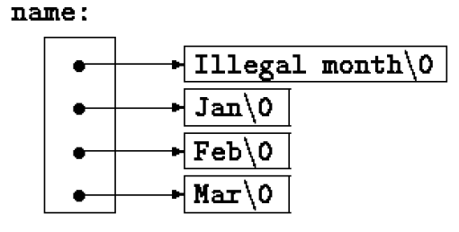
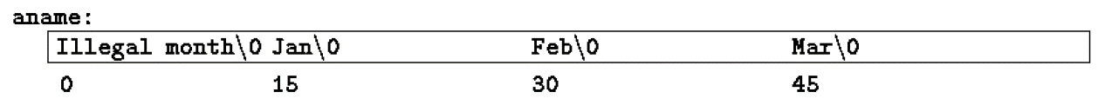
Arrays of Pointers Vs 2d array
char *name[] = { "Illegal month", "Jan", "Feb", "Mar" };
char aname[][15] = { "Illegal month", "Jan", "Feb", "Mar" };

Slide 40
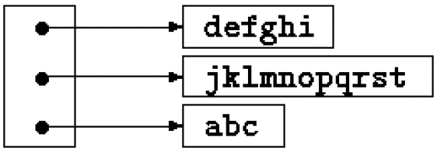
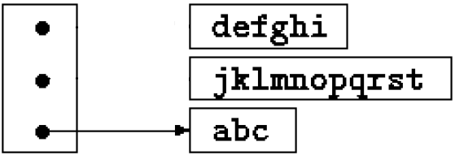
Swapping pointers
int main()
{
char *names[]={"defghi", "jklmnoprst", "abc"};
char *temp;
temp=names[0];
names[0]=names[1];
names[1]=temp;
return 0;
}

Slide 41
Arrays of Pointers to Strings
Limitations
int main()
{
int i;
char *names[6];
for( i=0; i<6; i++)
scanf("%s", names[i]);
return 0;
}
The program will crash
As no valid address is contained
But this works fine if each name length is below 20
int main()
{
int i;
char names[6][20];
for( i=0; i<6; i++)
scanf("%s", names[i]);
return 0;
}

Slide 42
Pointers and Arrays
Pointer version is faster
But sometimes difficult to understand

Slide 43
Multiple Indirection
int main()
{
char **mp, *p, ch;
p=&ch;
mp=&p;
**mp='A';
printf("%c\n", ch);
return 0;
}
mp |  |  | p |  |  | ch
???? | … | … | ???? | … | … | ????
5166 |  |  | 7092 |  |  | 7541
7092
7541
‘A’

Slide 44
Pointer to void
is used to hold any type of pointer
int n;
char c;
int *ip=&n;
char *cp=&c;
void *vp;
ip = cp; /* illegal */
vp = ip; /* ok*/
Cannot be de-referenced without type casting.
int x = *vp; /* illegal without type casting*/
int y = *((int *)vp); /* ok */

Slide 45
Dynamic Allocation
void * malloc(size_t numbytes);
  size_t is an unsigned integral type
  numbytes is required bytes to be allocated
  returns a pointer to the beginning of the allocated memory
  Returns NULL if the request fails
  Needs to include stdlib.h
void free (void *ptr);
  Frees allocated memory starting from address contained in the pointer ptr
  Bytes allocated by malloc() is never released without calling free()
    Even if you allocate the bytes inside a function

Slide 46
Dynamic Allocation
#include<stdio.h>
#include<stdlib.h>
#define SIZE 5
int main()
{
char *p;
p=(char*)malloc(SIZE);
if(p)
{
scanf("%s", p);
printf(p);
}
free(p);
return 0;
}
#include<stdio.h>
#include<stdlib.h>
int main()
{
char *p;
p=(char*)malloc(80);
if(p)
{
scanf("%s", p);
printf(p);
}
free(p);
return 0;
}

Slide 47
Dynamic Allocation
#include<stdio.h>
#include<stdlib.h>
int main()
{
char *p;
int n;
scanf("%d", &n);
p=(char*)malloc(n);
if(p)
{
scanf("%s", p);
printf(p);
}
free(p);
return 0;
}

Slide 48
Dynamic Allocation
#include<stdio.h>
#include<stdlib.h>
int main()
{
int *p, i, n;
scanf("%d", &n);
p=(int*)malloc(n * sizeof(int));
if(p)
{
for(i=0; i<n; i++)
{
scanf("%d", &p[i]);
printf("p %d is %d\n", i, p[i]);
}
}
free(p);
return 0;
}

Slide 49
How to dynamically allocate a 2D array?
#include <stdio.h>
#include <stdlib.h>
int main()
{
int r = 5, c = 7;
int *arr = (int *)malloc(r * c * sizeof(int));
int i, j, count = 0;
for (i = 0; i < r; i++)
for (j = 0; j < c; j++)
*(arr + i*c + j) = ++count;
for (i = 0; i < r; i++)
for (j = 0; j < c; j++)
printf("%d ", *(arr + i*c + j));
return 0;
}
Using a single pointer:

Slide 50
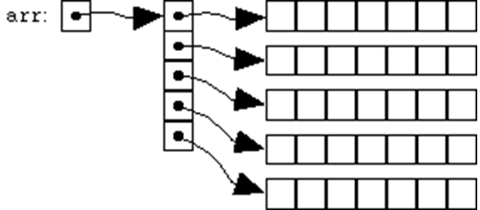
How to dynamically allocate a 2D array?
#include <stdio.h>
#include <stdlib.h>
int main()
{
int r = 5, c = 7, i, j, count;
int **arr = (int **)malloc(r * sizeof(int *));
for (i=0; i<r; i++)
arr[i] = (int *)malloc(c * sizeof(int));
/* Note that arr[i][j] is same as *(*(arr+i)+j)*/
count = 0;
for (i = 0; i < r; i++)
for (j = 0; j < c; j++)
arr[i][j] = ++count;
for (i = 0; i < r; i++)
for (j = 0; j < c; j++)
printf("%d ", arr[i][j]);
return 0;
}
Using a pointer to a pointer:

Slide 51
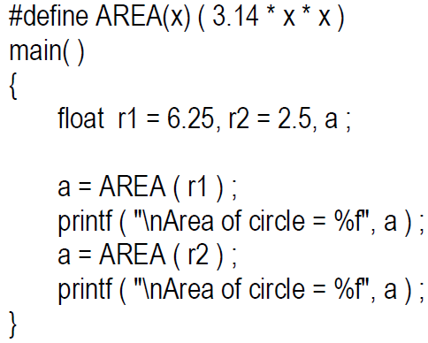
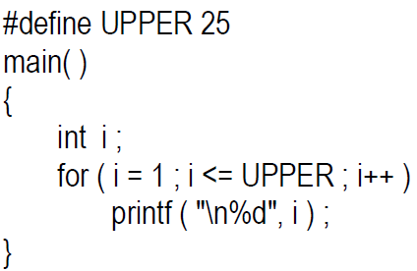
Preprocessor directive
File inclusion
  #include
Macro expansion
  #define macro-name character-sequence
  Need to use ( ) where necessary

