Slide 1
array
MAN

Slide 2
Consider a real life problem
Write a program that
  Takes the number of students N as input
  Takes the CT marks of N students
  Calculates the average, minimum and maximum marks of N students
We do not know the number of students N when coding
N can be very large
Let’s think for a while…

Slide 3
Array
A collection/list of variables of the same type
Accessed through a common name
Declaration
  type var_name[size];
    The size must be an integer constant greater than zero
  int myarray[20];
  int m[10], a[5];
Today we will deal with int, float, double
Later char inshaAllah

Slide 4
Array
Accessed by indexing
  Known as subscript
  Can be any valid integer expression
  Begin at 0
  myarray[1] : 2nd element
Array elements are stored in contiguous memory location
  The lowest address corresponds to the first element

Slide 5
Initialization
48 | 53 | 26 | 71 | 9 | 12
int n[6]={48, 53, 26,71, 9, 12};
float n[]={3.1, -5, 2.5, 17.4, 29};
  Array dimension optional
3.1 | -5 | 2.5 | 17.4 | 29

Slide 6
Memory layout
int a[5];
for(int i=0; i<5; i++) a[i]=i;
After the declaration
  20 bytes get reserved in memory
  Each integer 4 bytes long
 | a[0] | a[1] | a[2] | a[3] | a[4]
a | 0 | 1 | 2 | 3 | 4
 | 4002 | 4006 | 4010 | 4014 | 4018

Slide 7
Some important notes
Array element Can be used anywhere a variable/constant can
  int a[5];
  for(int i=0; i<5; i++) scanf("%d", &a[i]);
C compiler does not perform any bound checking on array index
It is programmer’s duty
Data entered with a subscript exceeding the array size will lead to unpredictable results
Program may crash
  int a[5];
  for(int i=0; i<5; i++) a[i]=i;
  printf("%d\n", a[10]);//a[5]

Slide 8
Array copy
It is not possible to assign one entire array to other array
int a1[5], a2[5];
a1=a2; //not possible
Need to copy explicitly
for(int i=0; i<5; i++) a1[i]=a2[i];

Slide 9
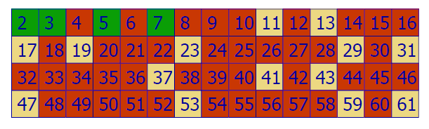
The Sieve of Eratosthenes

Slide 10
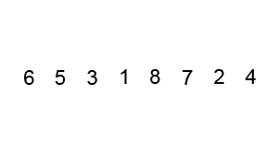
Bubble Sort

Slide 11
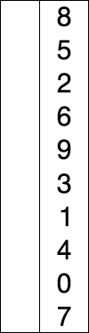
Selection Sort

Slide 12
Multidimensional array
Arrays of two or more dimension
int count[10][12];
2-d array
  Actually an array of one dimensional arrays
  Easy to think in Row, column format, matrix
  Usually accessed a row at a time from left to right
 | 0 | 1 | 2 | 3 | 4
0 | a[0][0] | a[0][1] | a[0][2] | a[0][3] | a[0][4]
1 | a[1][0]
2
3 | a[3][0] |  |  |  | a[3][4]
Row subscript
Column subscript

Slide 13
Multidimensional array
  for(i=0; i<4; i++)
  {
  for(j=0; j<5; j++)
  printf("%d ", td[i][j]);
  printf("\n");
  }
  return 0;
}
#include<stdio.h>
int main()
{
int td[4][5];
int i, j;
for(i=0; i<4; i++)
for(j=0; j<5; j++)
td[i][j]=i*j;
Output:
0 0 0 0 0
0 1 2 3 4
0 2 4 6 8
0 3 6 9 12

Slide 14
Multidimensional array
Initialization:
int sqr[3][3] ={
1,2,3,
4,5,6,
7,8,9
};
Initialization:
Specify all but the leftmost dimension
int sqr[][3] ={
1,2,3,
4,5,6,
7,8,9
};
 | Col no. 0 | Col no. 1 | Col no. 2
Row no. 0 | 1 | 2 | 3
Row no. 1 | 4 | 5 | 6
Row no. 2 | 7 | 8 | 9

Slide 15
Multidimensional array
Initialization:
int sqr[3][3] ={
{1,2,3},
{4,5,6},
{7,8,9}
};
int sqr[3][3] ={1,2,3,4,5,6,7,8,9};
int sqr[][3] ={1,2,3,4,5,6,7,8,9};

Slide 16
Multidimensional array
Initialization:
int sqr[3][] ={1,2,3,4,5,6,7,8,9};
int sqr[][] ={1,2,3,4,5,6,7,8,9};
This would never work

Slide 17
Memory layout
Arrangement of 2-D array in memory
Memory doesn’t contain row and columns
Elements are stored in one continuous chain
S[0][0] | S[0][1] | S[0][2] | S[1][0] | S[1][1] | S[1][2] | S[2][0] | S[2][1] | S[2][2]
1 | 2 | 3 | 4 | 5 | 6 | 7 | 8 | 9
5002 | 5006 | 5010 | 5014 | 5018 | 5022 | 5026 | 5030 | 5034

Slide 18
Multidimensional array
int th[4][2][7]

Slide 19
Multidimensional array
int arr[3][3][2]={
{
{2,4},
{7,8},
{4,9}
},
{
{7,6},
{5,1},
{3,4}
},
{
{2,3},
{7,2},
{9,4}
}
}

Slide 20
Thanks to
Johra Muhammad Moosa
  Lecturer
  Department of Computer Science & Engineering
  Bangladesh University of Engineering & Technology

