Slide 1
object oriented programming with C++
MAN

Slide 2
The C language
A procedural language
Follows procedure/function oriented programming
Program is divided into functions
each function has a clearly defined purpose
You can perform many task regarding EEE using C

Slide 3
You have leaned C Congratulations!!!

Slide 4
Why do we need to learn C++?

Slide 5
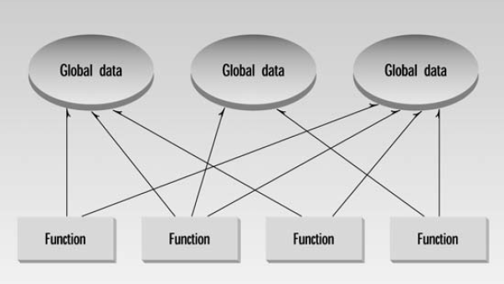
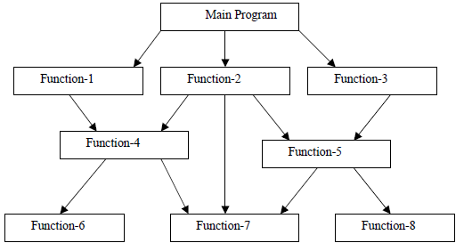
Limitation of C
Functions have unrestricted access to global data
many important data items are placed as global
so that they may be accessed by all the functions
In a large program, there are many functions and many global data items
When programs become large it is difficult to
Understand
Modify

Slide 6
Limitation of C
Arrangement of separate data and functions fail to represent real-world objects easily
Student
Book
Electrical components
Real-world objects have both properties and operations
Book
Properties: Name, Author, Price…
can be represented by data
Operations: Print, Change Price, Sell, Rent…
Can be represented by functions

Slide 7
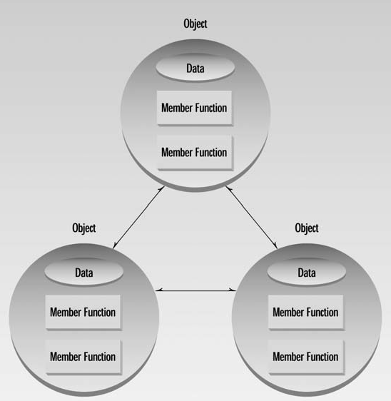
Solution: OOP
Object Oriented Programming
A powerful style of programming
Combine into a single unit
Data
Functions that operate on that data
This unit is called Object
Program is divided into Objects
Not possible with C

Slide 8
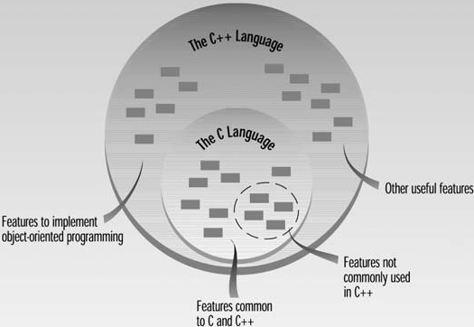
C++
Superset of C
Supports both
Procedure/Function Oriented Programming
Object Oriented Programming

Slide 9
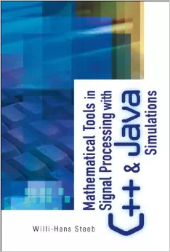
Application of OOP
Real-time system
Simulation and modeling
Object-oriented data bases
AI and expert systems
Decision support and office automation systems
…

Slide 10
So Let’s start learning C++ right now!!!

Slide 11
class
The most important feature of C++
Extension of structure in C
Combines related data and functions together
Class definition has 2 parts
Class declaration
Member function definition

Slide 12
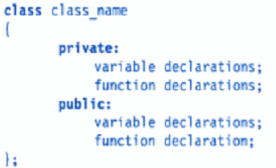
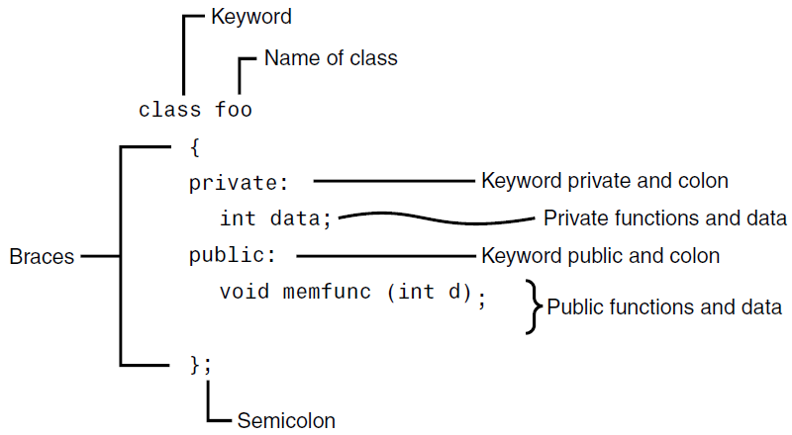
Class declaration

Slide 13
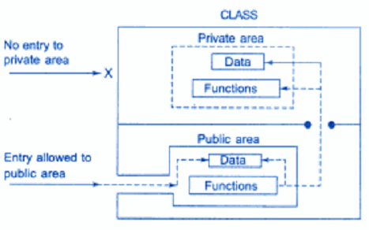
Encapsulation/data hiding
A key feature OOP
Data is concealed inside a class
it cannot be modified mistakenly by functions outside the class

Slide 14
Encapsulation/data hiding
The primary mechanism for hiding data is to put it in a class and make it private
The keywords private and public are called visibility labels
Private data and functions can only be accessed from within the class itself
Public data and functions are accessible outside the class

Slide 15
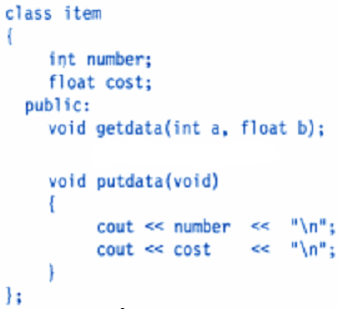
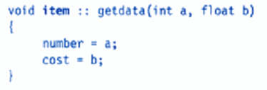
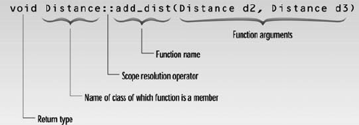
Member function definition
Inside class definition
Outside class definition using scope resolution operator (::)
printf(“%d %f”,number, cost);

Slide 16
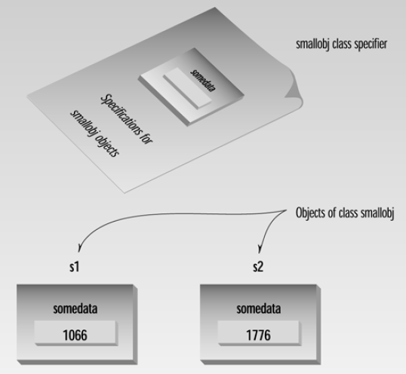
Creating objects
Class is a used defined type
For utilizing the defined class, we need variables of the class type as: smallobj s1,s2;
//like int i,j;
In C++ class variables are known as objects

Slide 17
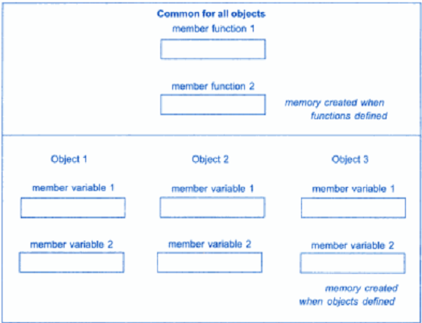
Memory allocation for objects
member functions are created and stored in memory only once when the class is defined
Shared by all the objects related to that class
Memory space is allocated separately to each object for their data members
Member variables store different values for different objects of a class.

Slide 18
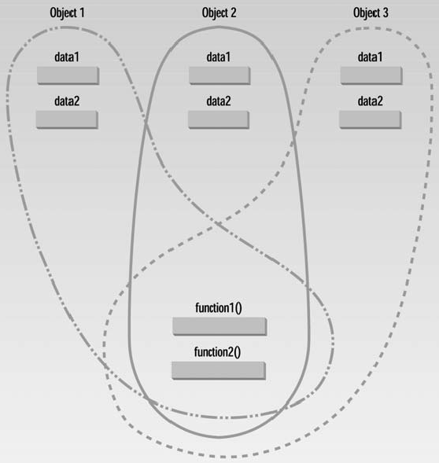
Memory allocation for objects
member functions are created and stored in memory only once when the class is defined
Shared by all the objects related to that class
Memory space is allocated separately to each object for their data members
Member variables store different values for different objects of a class.

Slide 19
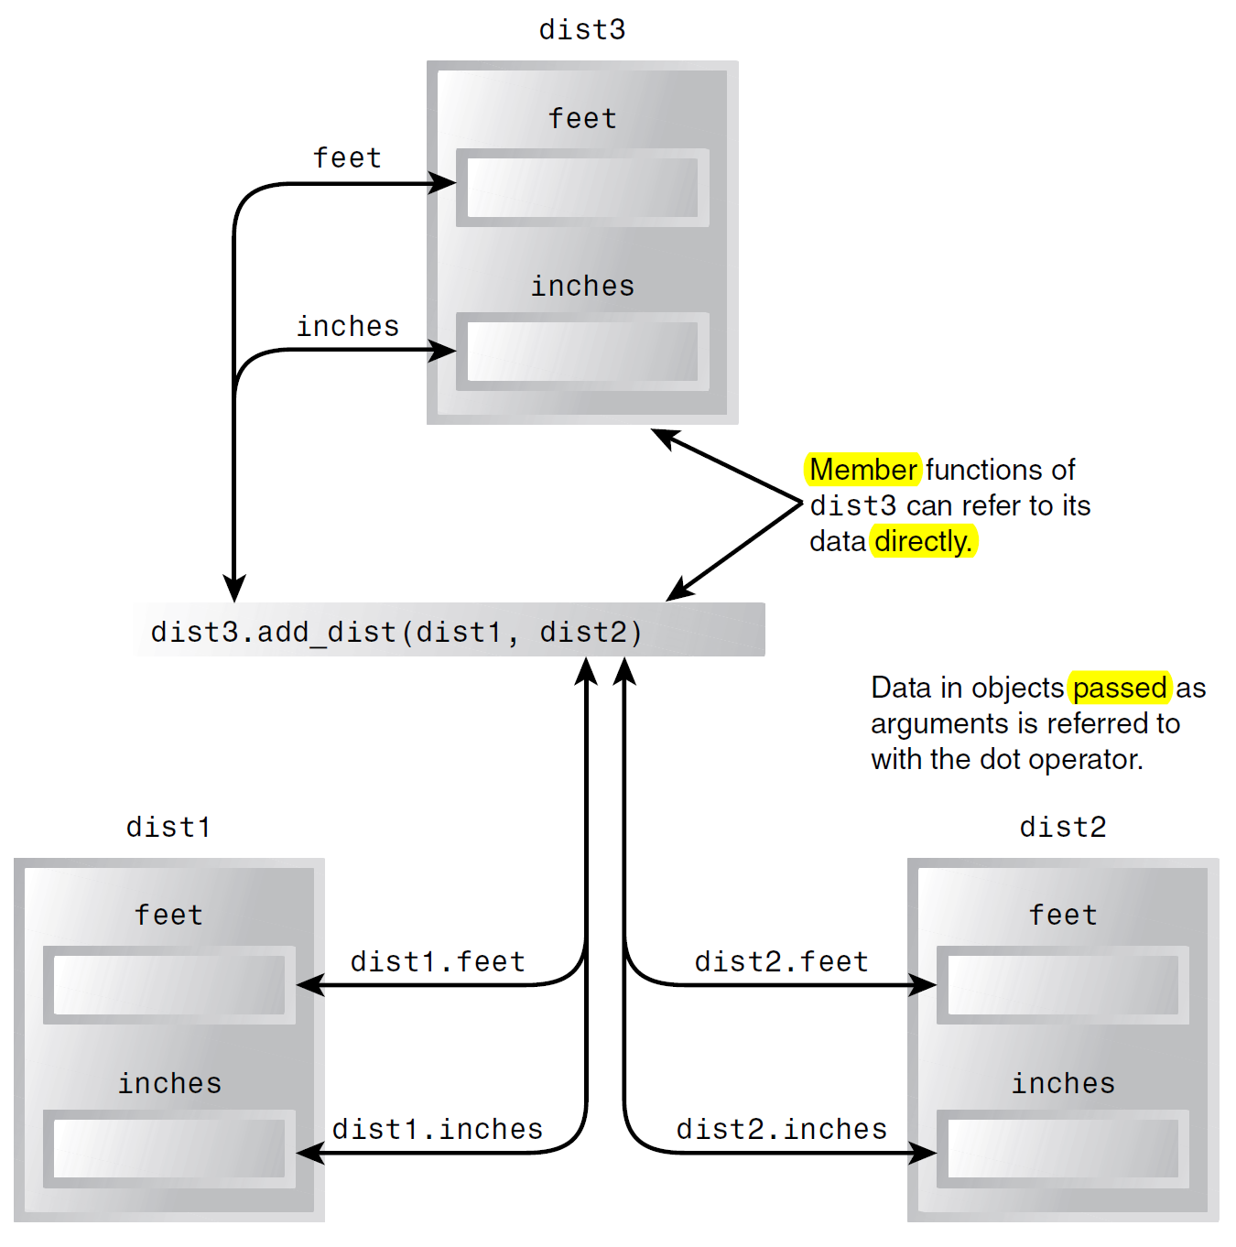
Objects as Arguments

Slide 20
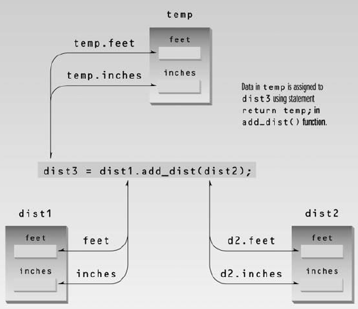
Objects as Arguments

Slide 21
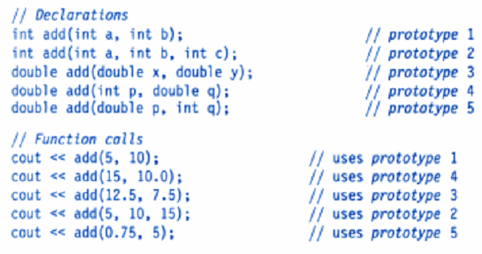
Function overloading
Use of same function name to create functions that perform a variety of different tasks
The number/type of argument must be varied
The correct function to be called is determined by checking the number and type of arguments

Slide 22
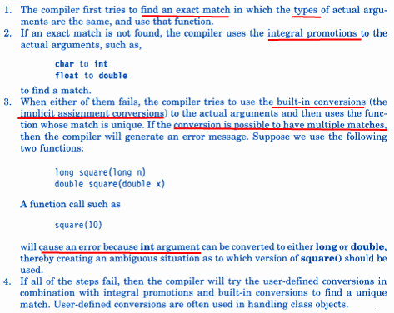
Function overloading

Slide 23
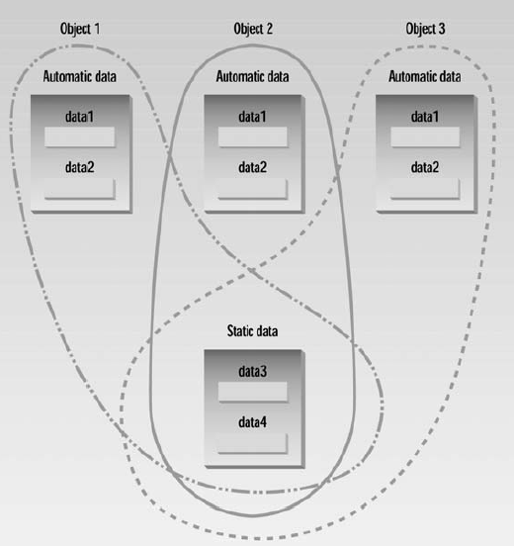
Static data member

